Slide 1
Passenger
Parcel
AMoD + co-modal
AMoD
Autonomous Mobility on Demand

Slide 2
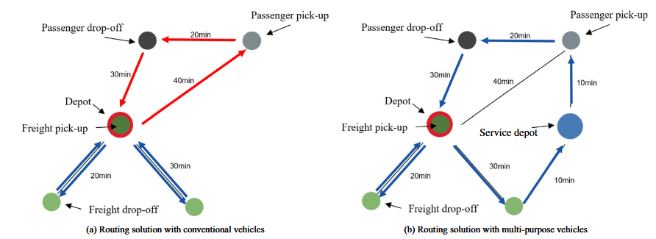
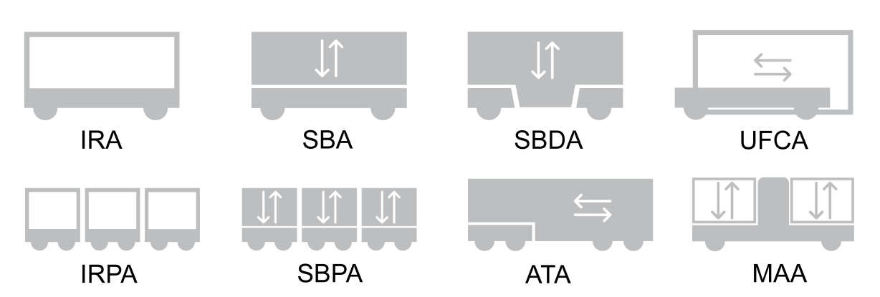
AMoD + co-modal
basic concept
state of art
research questions
vehicle concept
fleet management
What is a suitable architecture for vehicles with co-modality in the context of PureMobility?
NEXT
Co-modal VRP assessment
MAUDE
How to generate demand for the assessment of implementing co-modality in PureMobility?
Operating capacity share of co-modal vehicles
NXT
Pooling of Ride + Parcel
How can the fleet management with co-modality operated in PureMobility?

